Slide 1
Docker 101

Slide 2
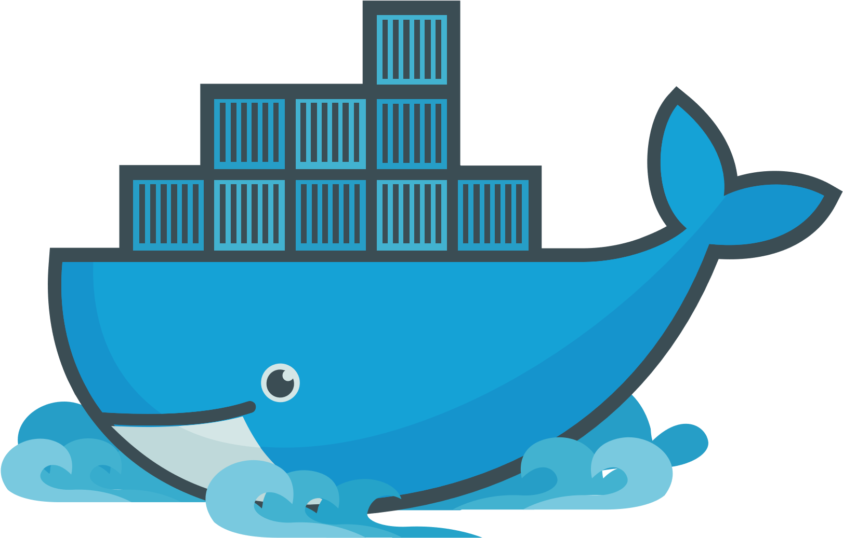

Slide 3
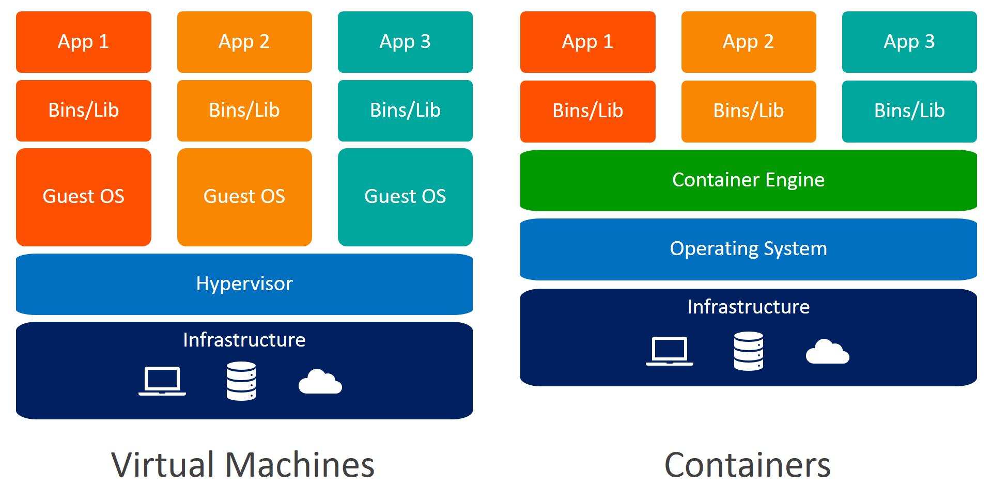
Virtualización a Nivel SO (Kernel)

Slide 4
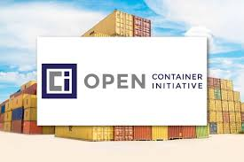
https://www.opencontainers.org/
Docker:
Docker Registry
Docker Daemon:
Docker Engine
Docker Host (API)
Docker CLI

Slide 5
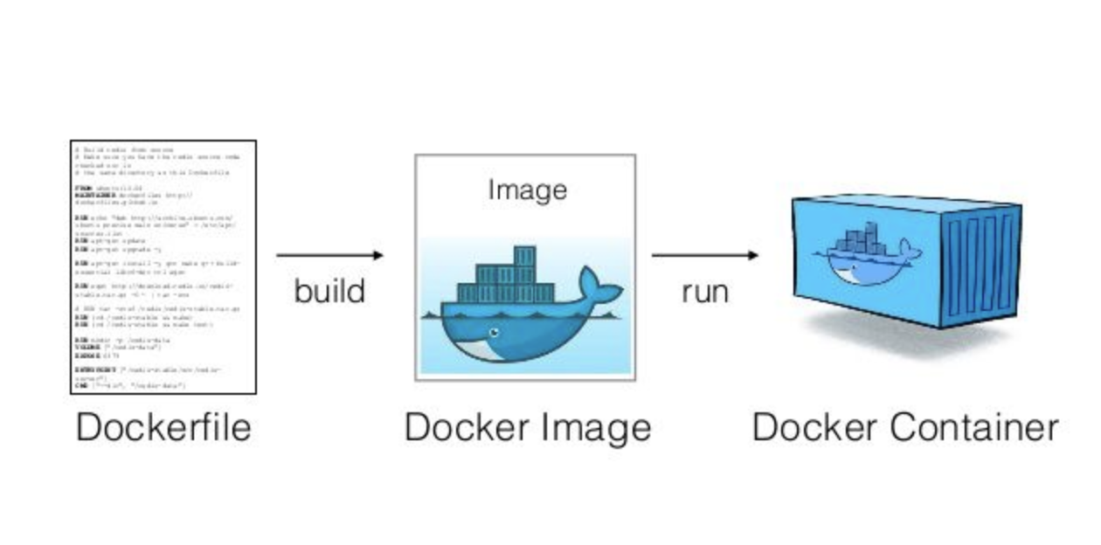

Slide 6
Comandos Básicos
Imagen
Contenedor
docker images
docker pull
docker run (-it) (-d) (-p) (-t)
docker rmi
docker ps (-a)
docker start
docker stop
docker rm

Slide 7
A jugar!!!
docker run –itd –p 8000:80 --name svr1 httpd
docker stat <contenedor>
docker logs <contenedor>
docker top <contenedor>

Slide 8
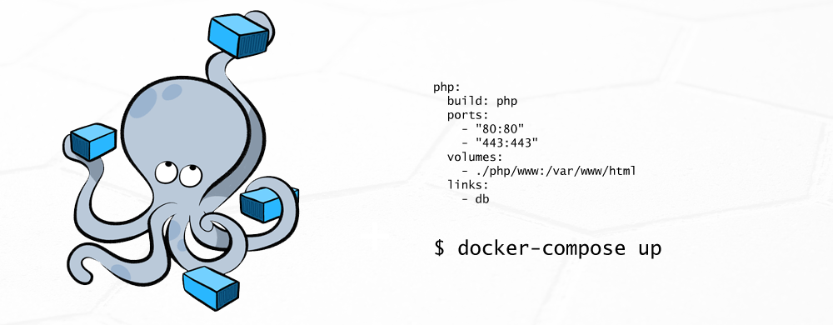

Slide 9
Comandos Basicos
◆ docker-compose up -d
◆ docker-compose ps
◆ docker-compose stop
◆ docker-compose restart
◆ docker-compose logs

Slide 10
